Slide 1
OpenDaylightを用いた Service Function Chainの調査報告
ソリューション事業部
SDIソリューションBU
加瀬祐太

Slide 2
目次
背景
Service Function Chaining(SFC)について
OpenDaylight(ODL) SFCについて
ODL SFC の利用方法
ODL SFCの実装
考察、感想
まとめ

Slide 3
背景
企業インフラを利用するユーザが、イメージするコンピュータリソース(コンピュート、ネットワーク)をワントップで提供可能な社内システムが欲しい…
Service Function ChainingとOSSのSDNプロジェクトOpenDaylightを用いることで解決できないか

Slide 4
Service Function Chaining
物理構成によらずリソースを仮想化し、ユーザに合わせたネットワーク環境を構築しよう
SV
SV
SV
A
SW
SW
B

Slide 5
SFC アーキテクチャ
SF
SF
SFP
Classifier
SFF
Classifier
: パケット
Controller
: ヘッダ
Notes:
このアーキテクチャはなに

Slide 6
SFC アーキテクチャ
SF
SF
SFP
Classifier
SFF
Classifier
: パケット
Controller
: ヘッダ

Slide 7
SFC アーキテクチャ
SF
SF
SFP
Classifier
SFF
Classifier
: パケット
Controller
: ヘッダ

Slide 8
SFC アーキテクチャ
Classifier ：
パケットごとに必要なヘッダをつけ外し
Classifier ：
パケットごとに必要なヘッダをつけ外し
SF
SF
SFP
Classifier
SFF
Classifier
: パケット
Controller
: ヘッダ
Notes:
パケット順に説明しますっていっったもんがち

Slide 9
SFC アーキテクチャ
Service Function Forwarder ：
ヘッダを参照しパケットを転送
SF
SF
SFP
Classifier
SFF
Classifier
: パケット
Controller
: ヘッダ

Slide 10
SFC アーキテクチャ
SF
SF
SFP
Classifier
Service Function ：
ネットワーク機能(LB, FW, DPI, …)
Classifier
Service Function ：
ネットワーク機能(LB, FW, DPI, …)
SFF
: パケット
Controller
: ヘッダ

Slide 11
SFC アーキテクチャ
SF
SF
SFP
Classifier
SFF
Classifier
Service Function Chaining Proxy ：
ヘッダ非対応SFのためにヘッダをつけ外し
: パケット
Controller
: ヘッダ

Slide 12
SFC アーキテクチャ
SF
SF
Controller：
ヘッダや経路の設定
SFP
Classifier
SFF
Classifier
: パケット
Controller
: ヘッダ

Slide 13
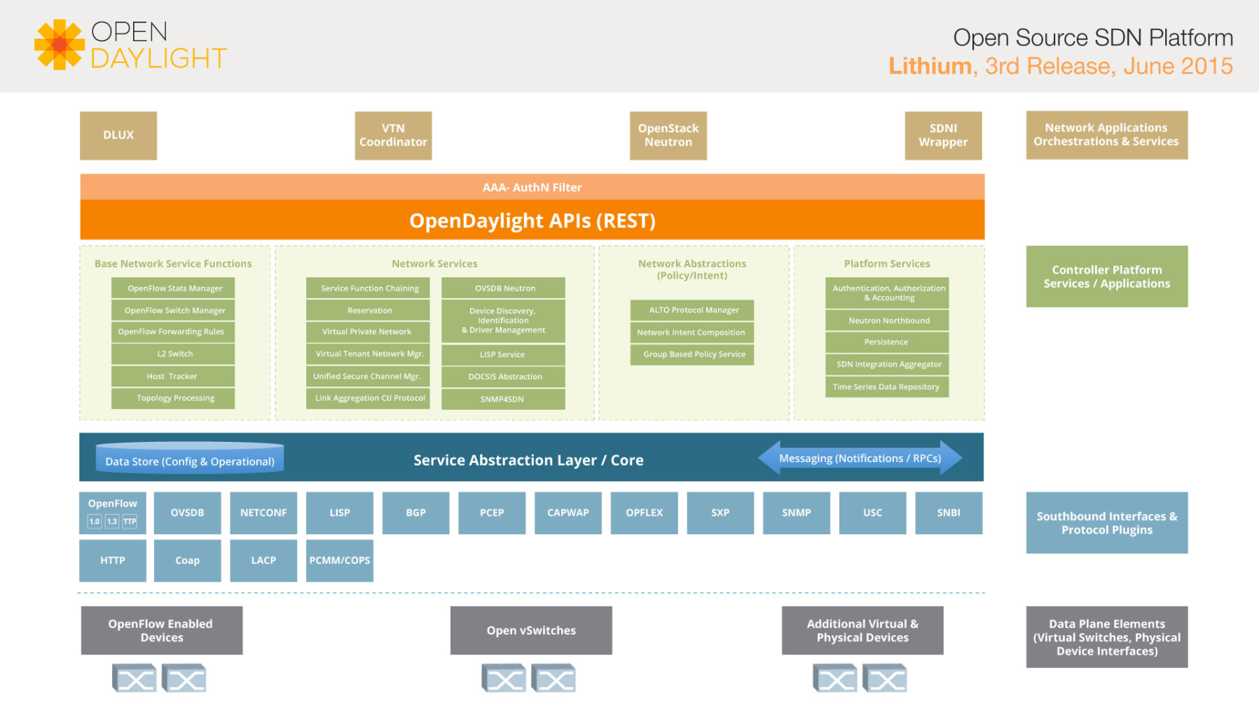
OpenDaylight
オープンソースのSDNコントローラー

Slide 14
OpenDaylight SFC
ODLのプロジェクトのひとつにSFCが存在
https://www.opendaylight.org/lithiumより抜粋

Slide 15
OpenDaylight SFC
アップ
https://www.opendaylight.org/lithiumより抜粋

Slide 16
OpenDaylight SFC
ODLのプロジェクトのひとつにSFCが存在
https://www.opendaylight.org/lithiumより抜粋

Slide 17
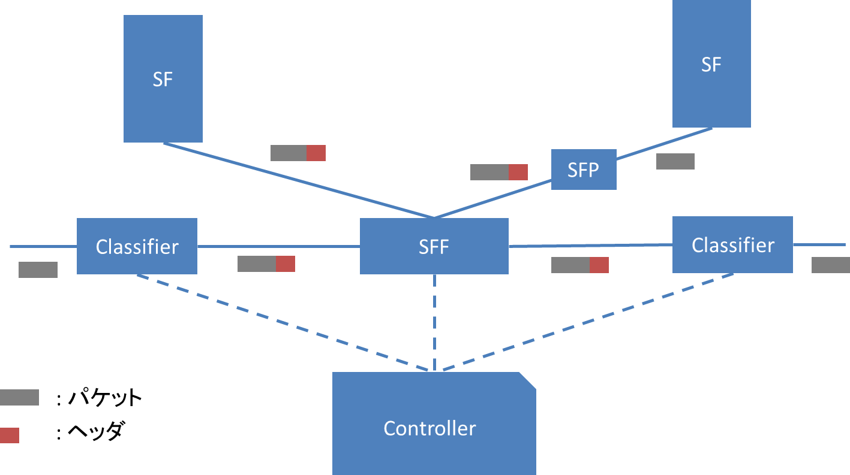
ODL SFC アーキテクチャ
コントローラー機能を実装、提供している
OpenDaylight
SFC
GUI
REST API

Slide 18
利用方法
デモが用意されているのでそれを参考にしながら…
192.168.1.7
Classifier
SFF
192.168.1.27
Controller
SF
192.168.1.13
デモURL ： https://docs.google.com/document/d/18xK9vL-lcfwuV3Bc7yayC00wC47oGIDDs8Z72SZz9SA/edit?usp=sharing
Notes:
図変更

Slide 19
環境
Controller ： OpenDaylight
SFF ： Open vSwitch
SF, Classifier ： Pythonスクリプト
192.168.1.7
Classifier
SFF
192.168.1.27
Controller
SF
192.168.1.13

Slide 20
環境
以下のような経路を実現
192.168.1.7
Classifier
SFF
192.168.1.27
Controller
SF
192.168.1.13

Slide 21
環境
Service Function Chain(SFC)
どんな種類のSFを繋ぐかという抽象的な定義
例 ： FW→LB→DPI
Service Function Path(SFP)
SFCを参照し、転送プロトコル等を指定
Rendered Service Path(RSP)
実際のパス、固有のIDが与えられる
SFPを参照
転送プロトコルやどのインスタンスを経由するかの情報を持つ

Slide 22
環境
ヘッダ
経路制御：VXLAN
経路選択：Network Service Header
192.168.1.7
Classifier
SFF
192.168.1.27
Controller
SF
192.168.1.13

Slide 23
環境構築
192.168.1.7
Classifier
SFF
192.168.1.27
Controller
SF
192.168.1.13

Slide 24
環境構築
ここ
192.168.1.7
Classifier
SFF
192.168.1.27
Controller
SF
192.168.1.13

Slide 25
環境構築(ODL)
利用環境：Virtual-Box + Ubuntu 14.04
JDK, Maven, gitをインストール
apt-get install mavenだとうまくいかない(Mavenのバージョンが古いため)
ODL SFCをクローン
stable/lithium ブランチを使用(master動かず…)
Mavenを使用しビルド、実行
mvn clean install –D skipTests
./sfc-karaf/target/assembly/bin/karaf
参考URL ： https://wiki.opendaylight.org/view/Install_On_Ubuntu_14.04
Notes:
Master日付

Slide 26
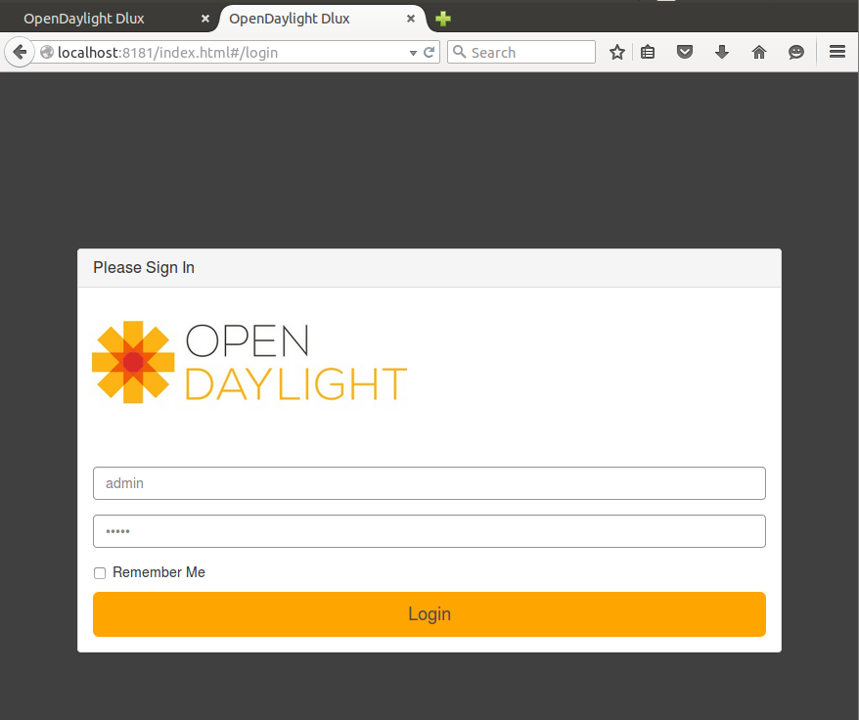
環境構築(ODL)
<controller-ip>:8181/index.html
username : admin, pass : admin

Slide 27
環境構築
ここ
192.168.1.7
Classifier
SFF
192.168.1.27
Controller
SF
192.168.1.13

Slide 28
環境構築(SFF)
Open vSwitch nsh-v8
NSHに対応したOpen vSwitch
初期設定用スクリプトが提供されている
https://raw.githubusercontent.com/priteshk/ovs/nsh-v8/third-party/start-ovs.sh
ODLに接続
sudo ovs-vsctl set-manager tcp:<controller-ip>:6640
現在のUbuntu14.04.4 LTSでは動かない
Open vSwitch nsh-v8は現在ovs 2.2.xまで対応
ovsの最新は2.4.x
ovs 2.2.xはLinux kernel 3.14までしか対応していない
3.19→3.13にダウングレードして対応
https://github.com/pritesh/ovs/blob/nsh-v8/FAQ

Slide 29
環境構築
ここ
192.168.1.7
Classifier
SFF
192.168.1.27
Controller
SF
192.168.1.13

Slide 30
環境構築(SF)
Python スクリプトを走らせるのみ
https://github.com/opendaylight/sfc/blob/stable/lithium/sfc-py/sfc/sfc_agent.py
依存パッケージがいくつかあるのでインストール

Slide 31
SFC 設定
GUIとREST APIの二種類が用意されている
OpenDaylight
SFC
GUI
REST API

Slide 32
設定項目
Service Function
Service Function Forwarder
Service Function Chain
Service Function Path
Rendered Service Path

Slide 33
Service Function
http://<controller-ip>:8181/restconf/config/service-function:service-functions/
{
"service-functions": {
"service-function": [
{
"name": "firewall-1",
"sf-data-plane-locator": [
{
"name": "firewall-1-dp1",
"ip": "192.168.1.13",
"port": 6633,
"transport": "service-locator:vxlan-gpe",
"service-function-forwarder": "SFF1"
}
],
"rest-uri": "http://192.168.1.13:5000",
"nsh-aware": true,
"ip-mgmt-address": "192.168.1.13",
"type": "service-function-type:firewall"
}
]
}

Slide 34
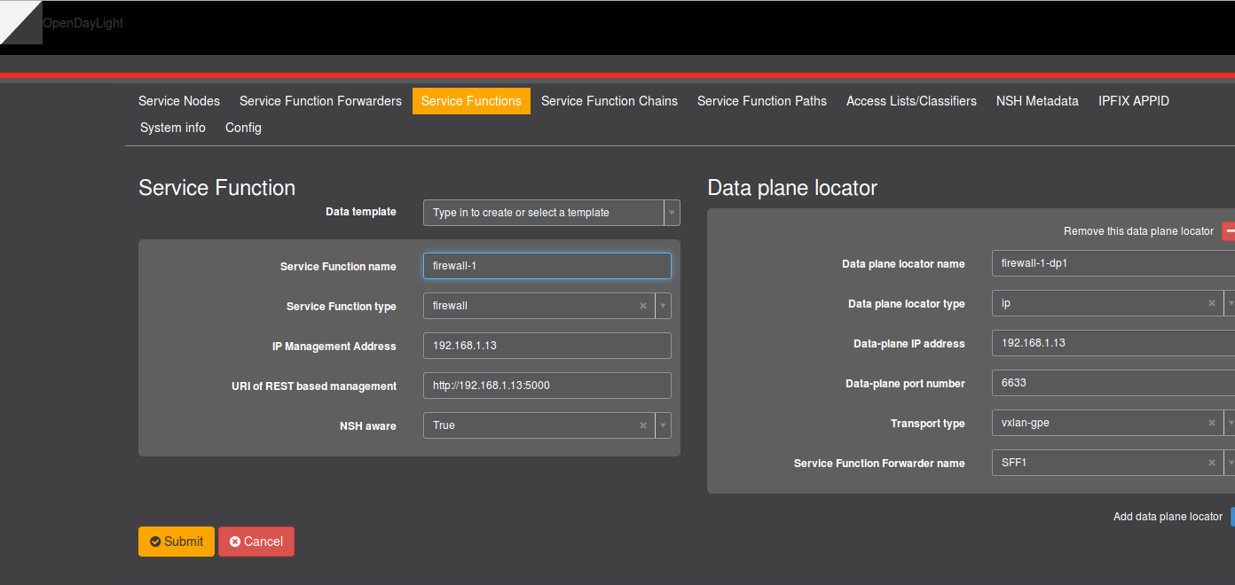
Service Function

Slide 35
Service Function Forwarder
http://<controller-ip>:8181/restconf/config/service-function-forwarder:service-function-forwarders/
{
"service-function-forwarders": {
"service-function-forwarder": [
{
"name": "SFF1",
"sff-data-plane-locator": [
{
"name": "sff1-dp1",
"service-function-forwarder-ovs:ovs-bridge": {},
"data-plane-locator": {
"transport": "service-locator:vxlan-gpe",
"port": 6633,
"ip": "192.168.1.27"
},
…
※一部抜粋
Notes:
{
"service-function-forwarders": {
"service-function-forwarder": [
{
"name": "SFF1",
"sff-data-plane-locator": [
{
"name": "sff1-dp1",
"service-function-forwarder-ovs:ovs-bridge": {},
"data-plane-locator": {
"transport": "service-locator:vxlan-gpe",
"port": 6633,
"ip": "192.168.1.27"
},
"service-function-forwarder-ovs:ovs-options": {
"nshc1": "flow",
"nsp": "flow",
"key": "flow",
"remote-ip": "flow",
"nsi": "flow",
"nshc2": "flow",
"nshc3": "flow",
"dst-port": "6633",
"nshc4": "flow"
}
}
],
"service-function-forwarder-ovs:ovs-bridge": {
"bridge-name": "br1"
},
"service-function-dictionary": [
{
"name": "firewall-1",
"type": "service-function-type:firewall",
"sff-sf-data-plane-locator": {
"service-function-forwarder-ovs:ovs-bridge": {},
"transport": "service-locator:vxlan-gpe",
"port": 6633,
"ip": "192.168.1.13"
}
}
],
"ip-mgmt-address": "192.168.1.27",
"service-node": ""
}
]
}
}

Slide 36
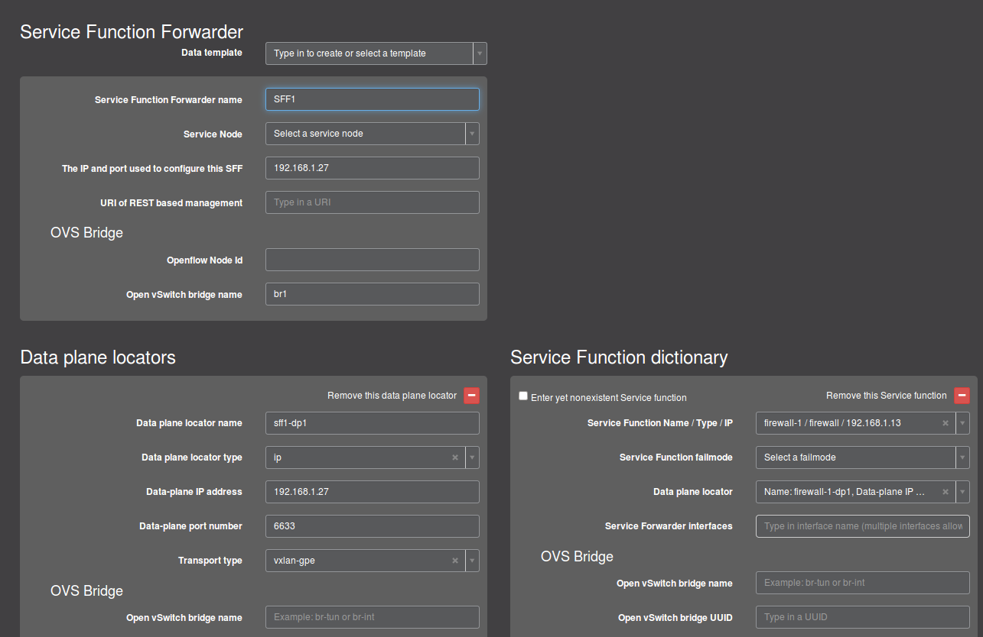
Service Function Forwarder
Notes:
{
"service-function-forwarders": {
"service-function-forwarder": [
{
"name": "SFF1",
"sff-data-plane-locator": [
{
"name": "sff1-dp1",
"service-function-forwarder-ovs:ovs-bridge": {},
"data-plane-locator": {
"transport": "service-locator:vxlan-gpe",
"port": 6633,
"ip": "192.168.1.27"
},
"service-function-forwarder-ovs:ovs-options": {
"nshc1": "flow",
"nsp": "flow",
"key": "flow",
"remote-ip": "flow",
"nsi": "flow",
"nshc2": "flow",
"nshc3": "flow",
"dst-port": "6633",
"nshc4": "flow"
}
}
],
"service-function-forwarder-ovs:ovs-bridge": {
"bridge-name": "br1"
},
"service-function-dictionary": [
{
"name": "firewall-1",
"type": "service-function-type:firewall",
"sff-sf-data-plane-locator": {
"service-function-forwarder-ovs:ovs-bridge": {},
"transport": "service-locator:vxlan-gpe",
"port": 6633,
"ip": "192.168.1.13"
}
}
],
"ip-mgmt-address": "192.168.1.27",
"service-node": ""
}
]
}
}

Slide 37
Service Function Chain
http:://<controller-ip>:8181/restconf/config/service-function-chain:service-function-chains/
{
"service-function-chains": {
"service-function-chain": [
{
"name": "Chain-1",
"sfc-service-function": [
{
"name": "firewall-1",
"order": 0,
"type": "service-function-type:firewall"
}
]
}
]
}
}
Notes:
{
"service-function-forwarders": {
"service-function-forwarder": [
{
"name": "SFF1",
"sff-data-plane-locator": [
{
"name": "sff1-dp1",
"service-function-forwarder-ovs:ovs-bridge": {},
"data-plane-locator": {
"transport": "service-locator:vxlan-gpe",
"port": 6633,
"ip": "192.168.1.27"
},
"service-function-forwarder-ovs:ovs-options": {
"nshc1": "flow",
"nsp": "flow",
"key": "flow",
"remote-ip": "flow",
"nsi": "flow",
"nshc2": "flow",
"nshc3": "flow",
"dst-port": "6633",
"nshc4": "flow"
}
}
],
"service-function-forwarder-ovs:ovs-bridge": {
"bridge-name": "br1"
},
"service-function-dictionary": [
{
"name": "firewall-1",
"type": "service-function-type:firewall",
"sff-sf-data-plane-locator": {
"service-function-forwarder-ovs:ovs-bridge": {},
"transport": "service-locator:vxlan-gpe",
"port": 6633,
"ip": "192.168.1.13"
}
}
],
"ip-mgmt-address": "192.168.1.27",
"service-node": ""
}
]
}
}

Slide 38
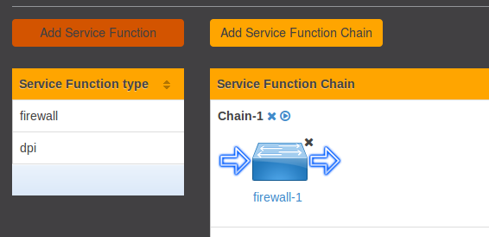
Service Function Chain
Notes:
{
"service-function-forwarders": {
"service-function-forwarder": [
{
"name": "SFF1",
"sff-data-plane-locator": [
{
"name": "sff1-dp1",
"service-function-forwarder-ovs:ovs-bridge": {},
"data-plane-locator": {
"transport": "service-locator:vxlan-gpe",
"port": 6633,
"ip": "192.168.1.27"
},
"service-function-forwarder-ovs:ovs-options": {
"nshc1": "flow",
"nsp": "flow",
"key": "flow",
"remote-ip": "flow",
"nsi": "flow",
"nshc2": "flow",
"nshc3": "flow",
"dst-port": "6633",
"nshc4": "flow"
}
}
],
"service-function-forwarder-ovs:ovs-bridge": {
"bridge-name": "br1"
},
"service-function-dictionary": [
{
"name": "firewall-1",
"type": "service-function-type:firewall",
"sff-sf-data-plane-locator": {
"service-function-forwarder-ovs:ovs-bridge": {},
"transport": "service-locator:vxlan-gpe",
"port": 6633,
"ip": "192.168.1.13"
}
}
],
"ip-mgmt-address": "192.168.1.27",
"service-node": ""
}
]
}
}

Slide 39
Service Function Path
http:// <controller-ip>:8181/restconf/config/service-function-path:service-function-paths/
{
"service-function-paths": {
"service-function-path": [
{
"name": "Chain-1-Path-1",
"service-chain-name": "Chain-1"
}
]
}
}
Notes:
{
"service-function-forwarders": {
"service-function-forwarder": [
{
"name": "SFF1",
"sff-data-plane-locator": [
{
"name": "sff1-dp1",
"service-function-forwarder-ovs:ovs-bridge": {},
"data-plane-locator": {
"transport": "service-locator:vxlan-gpe",
"port": 6633,
"ip": "192.168.1.27"
},
"service-function-forwarder-ovs:ovs-options": {
"nshc1": "flow",
"nsp": "flow",
"key": "flow",
"remote-ip": "flow",
"nsi": "flow",
"nshc2": "flow",
"nshc3": "flow",
"dst-port": "6633",
"nshc4": "flow"
}
}
],
"service-function-forwarder-ovs:ovs-bridge": {
"bridge-name": "br1"
},
"service-function-dictionary": [
{
"name": "firewall-1",
"type": "service-function-type:firewall",
"sff-sf-data-plane-locator": {
"service-function-forwarder-ovs:ovs-bridge": {},
"transport": "service-locator:vxlan-gpe",
"port": 6633,
"ip": "192.168.1.13"
}
}
],
"ip-mgmt-address": "192.168.1.27",
"service-node": ""
}
]
}
}

Slide 40
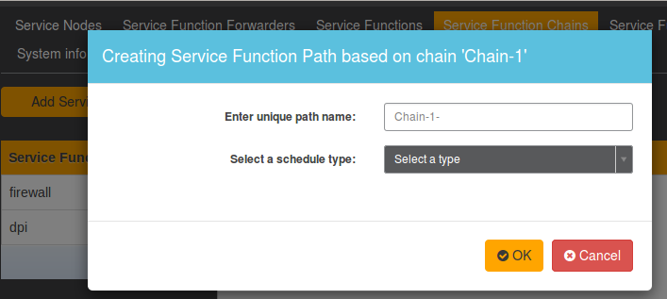
Service Function Path
Notes:
{
"service-function-forwarders": {
"service-function-forwarder": [
{
"name": "SFF1",
"sff-data-plane-locator": [
{
"name": "sff1-dp1",
"service-function-forwarder-ovs:ovs-bridge": {},
"data-plane-locator": {
"transport": "service-locator:vxlan-gpe",
"port": 6633,
"ip": "192.168.1.27"
},
"service-function-forwarder-ovs:ovs-options": {
"nshc1": "flow",
"nsp": "flow",
"key": "flow",
"remote-ip": "flow",
"nsi": "flow",
"nshc2": "flow",
"nshc3": "flow",
"dst-port": "6633",
"nshc4": "flow"
}
}
],
"service-function-forwarder-ovs:ovs-bridge": {
"bridge-name": "br1"
},
"service-function-dictionary": [
{
"name": "firewall-1",
"type": "service-function-type:firewall",
"sff-sf-data-plane-locator": {
"service-function-forwarder-ovs:ovs-bridge": {},
"transport": "service-locator:vxlan-gpe",
"port": 6633,
"ip": "192.168.1.13"
}
}
],
"ip-mgmt-address": "192.168.1.27",
"service-node": ""
}
]
}
}

Slide 41
Rendered Service Path
http:// <controller-ip>:8181/restconf/operational/rendered-service-path:rendered-service-paths/
{
"input": {
"name": "Chain-1-Path-1-Path-100",
"parent-service-function-path": "Chain-1-Path-1"
}
}
Notes:
{
"service-function-forwarders": {
"service-function-forwarder": [
{
"name": "SFF1",
"sff-data-plane-locator": [
{
"name": "sff1-dp1",
"service-function-forwarder-ovs:ovs-bridge": {},
"data-plane-locator": {
"transport": "service-locator:vxlan-gpe",
"port": 6633,
"ip": "192.168.1.27"
},
"service-function-forwarder-ovs:ovs-options": {
"nshc1": "flow",
"nsp": "flow",
"key": "flow",
"remote-ip": "flow",
"nsi": "flow",
"nshc2": "flow",
"nshc3": "flow",
"dst-port": "6633",
"nshc4": "flow"
}
}
],
"service-function-forwarder-ovs:ovs-bridge": {
"bridge-name": "br1"
},
"service-function-dictionary": [
{
"name": "firewall-1",
"type": "service-function-type:firewall",
"sff-sf-data-plane-locator": {
"service-function-forwarder-ovs:ovs-bridge": {},
"transport": "service-locator:vxlan-gpe",
"port": 6633,
"ip": "192.168.1.13"
}
}
],
"ip-mgmt-address": "192.168.1.27",
"service-node": ""
}
]
}
}

Slide 42
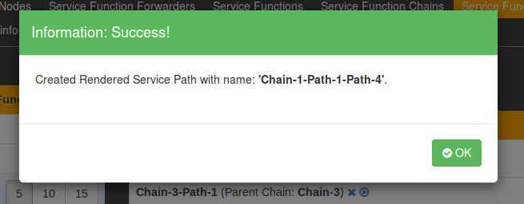
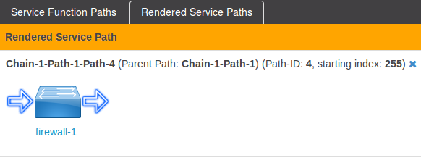
Rendered Service Path
Notes:
{
"service-function-forwarders": {
"service-function-forwarder": [
{
"name": "SFF1",
"sff-data-plane-locator": [
{
"name": "sff1-dp1",
"service-function-forwarder-ovs:ovs-bridge": {},
"data-plane-locator": {
"transport": "service-locator:vxlan-gpe",
"port": 6633,
"ip": "192.168.1.27"
},
"service-function-forwarder-ovs:ovs-options": {
"nshc1": "flow",
"nsp": "flow",
"key": "flow",
"remote-ip": "flow",
"nsi": "flow",
"nshc2": "flow",
"nshc3": "flow",
"dst-port": "6633",
"nshc4": "flow"
}
}
],
"service-function-forwarder-ovs:ovs-bridge": {
"bridge-name": "br1"
},
"service-function-dictionary": [
{
"name": "firewall-1",
"type": "service-function-type:firewall",
"sff-sf-data-plane-locator": {
"service-function-forwarder-ovs:ovs-bridge": {},
"transport": "service-locator:vxlan-gpe",
"port": 6633,
"ip": "192.168.1.13"
}
}
],
"ip-mgmt-address": "192.168.1.27",
"service-node": ""
}
]
}
}

Slide 43
動作確認
ホストとClassifierを模擬したスクリプト
https://github.com/opendaylight/sfc/blob/stable/lithium/sfc-py/sfc/sff_client.py
実行
python3.4 sff_client.py --remote-sff-ip 192.168.1.27 --local-port 6633 --remote-sff-port 6633 --sfp-id 1 --sfp-index 255 --encapsulate vxlan-nsh-ethernet-legacy --inner-src-ip 192.168.0.1 --inner-dest-ip 192.168.1.13 --inner-src-port 10000 --inner-dest-port 20000 --ctx1 192.168.1.7
Notes:
ホストと暮らしファイヤーを模擬したスクリプト

Slide 44
動作確認
192.168.1.7
SF2
192.168.1.14
Classifier
SFF
192.168.1.27
Controller
SF1
192.168.1.13

Slide 45
Demo

Slide 46
ODL SFC 実装
ヘッダ
フローテーブル
Classifier

Slide 47
ヘッダ
デモではNetwork Service Header + VXLAN
別の方法でも可能
GRE,VLAN,MPLS…
パケットレイアウト
Outer L2
Outer L3
Outer L4(UDP)
VXLAN
NSH
original
Notes:
具体的な別の技術
役割を明確に

Slide 48
Network Service Header
Base Header
Service Path Header
Mandatory Context Header
Mandatory Context Header
Mandatory Context Header
Mandatory Context Header
Optional Variable Length Context Header

Slide 49
Service Function Forwarder
RSPからフローテーブルが自動生成される
OpenFlow以外のプロトコルでも可能？
そもそもODLがそういう思想
OpenFlow以外の資料は見つけられなかった
Notes:
ほかの技術
Linux kernel
フローテーブル

Slide 50
フローテーブル
cookie=0x14, duration=2479.034s, table=0, n_packets=3, n_bytes=138, priority=250,ip actions=goto_table:3
cookie=0x14, duration=2479.090s, table=3, n_packets=1, n_bytes=46, priority=5 actions=goto_table:10
cookie=0x14, duration=2479.050s, table=3, n_packets=1, n_bytes=46, priority=540,nsp=2,nsi=255 actions=load:0xc0a8010e->NXM_NX_TUN_IPV4_DST[],goto_table:10
cookie=0x14, duration=2479.001s, table=3, n_packets=1, n_bytes=46, priority=540,nsp=2,nsi=254 actions=load:0xc0a8010d->NXM_NX_TUN_IPV4_DST[],goto_table:10
cookie=0xba5eba11ba5eba11, duration=2479.038s, table=10, n_packets=1, n_bytes=46, priority=640,nsp=2,nsi=255 actions=move:NXM_NX_NSH_C1[]->NXM_NX_NSH_C1[],move:NXM_NX_NSH_C2[]->NXM_NX_NSH_C2[],move:NXM_NX_TUN_ID[0..31]->NXM_NX_TUN_ID[0..31],IN_PORT
cookie=0xba5eba11ba5eba11, duration=2479.009s, table=10, n_packets=1, n_bytes=46, priority=640,nsp=2,nsi=254 actions=move:NXM_NX_NSH_C1[]->NXM_NX_NSH_C1[],move:NXM_NX_NSH_C2[]->NXM_NX_NSH_C2[],move:NXM_NX_TUN_ID[0..31]->NXM_NX_TUN_ID[0..31],IN_PORT
cookie=0xba5eba11ba5eba11, duration=2478.982s, table=10, n_packets=1, n_bytes=46, priority=640,nsp=2,nsi=253 actions=move:NXM_NX_NSI[]->NXM_NX_NSI[],move:NXM_NX_NSP[]->NXM_NX_NSP[],move:NXM_NX_NSH_C1[]->NXM_NX_TUN_IPV4_DST[],move:NXM_NX_NSH_C2[]->NXM_NX_TUN_ID[0..31],IN_PORT

Slide 51
Classifier
デモではスクリプトが手動でヘッダを付与
ODLにAccess List という設定項目がある
パケットの情報とRSPのテーブル
この情報を用いることで実装可能
SFC_Agentでも代用可能
BerylliumではovsベースのClassifierの実装がされている

Slide 52
考察、感想
かなりきれいに実装が隠ぺいされている
GUI、REST API
最低限の環境は整っている
使いやすいかはまた別
まだまだこれから？
アップデートで結構変わってるっぽい
ヘッダを利用しないOpenFlowベースのSFCも進められている(SFFで毎回classifierが走るイメージ)
ODLリッチすぎ
SFC_Agentの正体がわからなかった…

Slide 53
インターン通して
本当に勉強になりました
視野が広がりました

Slide 54
まとめ
Service Function Chaining並びにOpenDaylightの調査を行った
OpenDaylightプロジェクトで積極的にSFCは研究、実装されている
充分に利用できるものだと考える、しかし同時にまだまだ発展途上である

Slide 55
三週間ありがとうございました！

